Slide 1
Presentation on Data Structures
Presented By
P.Vignan Mani

Slide 2
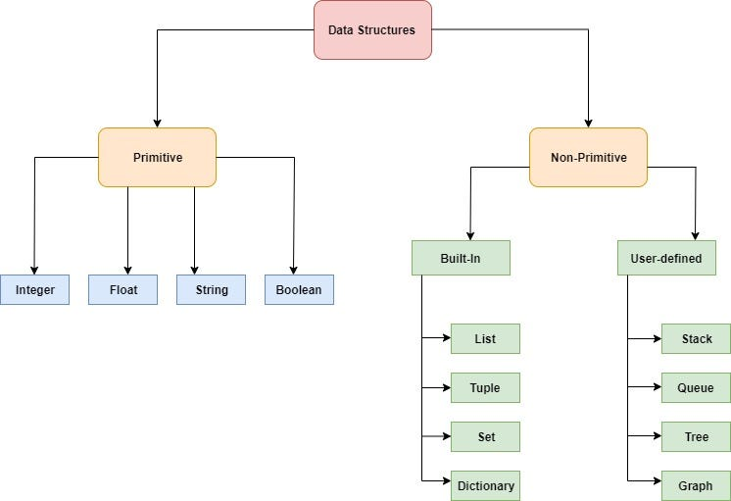
Flowchart of Data Types:

Slide 3
Differences between primitive and non primitive data types:
Primitive | Non-Primitive
Primitive data structures basic and fundamental ways of representing and storing data in a programming language. They are the building blocks for handling data and are directly supported by the language. | Non-primitive data structures are more complex data structures built using primitive data types. They are used to organize and manage multiple pieces of related data in a structured and efficient way.
Simple and basic. | Complex and can organize data.
Example: A single number.(int, float, complex, Boolean) | Example: A list of many numbers. (list, tuple, set, dictionary)

Slide 4
There are four in-built collection data structures in the Python programming language:
List is a collection which is ordered and changeable. It Allows duplicate values.
Tuple is a collection which is ordered and unchangeable. It Allows duplicate values.
Set is a collection which is unordered, unchangeable, and unindexed. Not allows duplicate values.
Dictionary is a collection which is ordered and changeable. Not allows duplicate values.

Slide 5
List:
A list in Python is a built-in data structure that represents an ordered collection of items.
Mutable: Lists can be modified after their creation. This means you can add, remove, or change elements within a list at any time.
Ordered: Lists maintain the order of their elements. Each item can be accessed by its index, starting from 0 for the first item, which allows for access to elements.
Allows Duplicates: Lists can contain same value, that means they allow duplicate values.

Slide 6
Tuple:
A tuple in Python is a built-in data structure that represents an ordered collection of items.
Immutable: Once a tuple is created, its values cannot be changed, we cannot add, remove, or modify values within it. This immutability makes tuples suitable for storing fixed collections of data, such as coordinates or database records
Ordered: Tuples maintain the order of their elements. Each item in a tuple can be accessed by its index, starting from 0 for the first item1
Allows Duplicates: Tuples can contain same values, that means they allow duplicate elements

Slide 7
Dictionary:
A dictionary in Python is a built-in data structure that represents an ordered collection of key-value pairs.
Unordered: dictionaries follow the insertion order, it means that items will be returned in the order they were added when iterating over them.
Mutable: Dictionaries can be modified after their creation. You can add new key-value pairs, update existing ones, or remove items at any time.
Key-Value Pairs: Each item in a dictionary is stored as a pair consisting of a unique key and its associated value. Keys must be immutable (e.g., strings, numbers, or tuples), while values can be of any data type and can be duplicated.

Slide 8
Set:
A set in Python is a built-in data structure used to store an unordered collection of unique items.
Unordered: Sets do not maintain any specific order for their elements, meaning that the items in a set are not indexed and cannot be accessed by position.
Unique Elements: Sets automatically remove duplicate entries, ensuring that each element is distinct within the collection.
Mutable: While the set itself can be modified (items can be added or removed), the elements contained within the set must be of an immutable type (e.g., integers, strings, or tuples).

Slide 9
Examples of Data Structures:
List: Ordered, Mutable, Allows Duplicates
Ex: fruits = [“Apple”, “Banana”, “mango”, “Apple”]
Tuple: Ordered, Immutable, Allows Duplicates
Ex: coordinates = (10.5, 20.3)
Dictionary: Ordered, Mutable, Key-Value Pairs
Ex: employee = {“name”: “Raju”, “age”: 23,”department”: “IT”}
Set: Unordered, Mutable, No Duplicates
Ex: numbers = [1, 2, 2, 3, 4]

Slide 10
Feature | List | Tuple | Dictionary | Set
Definition | Ordered, mutable collection of items | Ordered, immutable collection of items | Ordered, mutable collection of key-value pairs | Unordered, mutable collection of unique items
Syntax | [] | () | {key: value} | {}
Ordering | Ordered (maintains insertion order) | Ordered (maintains insertion order) | Ordered | Unordered (no guarantee of insertion order)
Mutability | Mutable (can be changed after creation) | Immutable (cannot be modified after creation) | Mutable (can add, remove or change key-value pairs) | immutable (cannot be modified after creation)
Duplicates | Allows duplicates | Allows duplicates | No duplicates (keys must be unique) | No duplicates (only unique elements allowed)
Indexing | Supports indexing, slicing, and iteration | Supports indexing and iteration | Does not support indexing (accessed via keys) | Does not support indexing (accessed via iteration)
Data Types | Can store mixed data types | Can store mixed data types | Keys must be immutable types; values can be any data type | Can store mixed data types
Use cases | Suitable for ordered collections, tasks where items may change frequently | Suitable for fixed, read-only collections | Suitable for mapping key-value pairs, lookups | Suitable for ensuring unique elements and set operations (union, intersection, etc.)
Parameter | Parameters can be indexed, sliced, and changed directly | Cannot be changed after creation, and parameters can be accessed via indexing | Parameters are accessed via keys and can be modified | Parameters are accessed via iteration only, no indexing

Slide 11


Slide 12


